Slide 1
The Socioeconomic Roots of Racial Disparities in Hospitalizations
SURE 2024
Nicole Sorensen, Macey Kalmanek, Cristina Antonacci, & Jainiah Harden
Notes:
- Jainiah
Red:
B01C33
Silver: B4B5B4
Black:1A1919

Slide 2


Preventing Hospital Stays Matters
In 2017, there was $33.7 billion in avoidable hospital expenses
Medicare rate 12x higher than ages 14 to 44.
Black patients face 4x more preventable stays than Asian/Pacific Islanders.
Patients face lower quality of life, prolonged recovery times, and patient suffering
How can we bridge the gap to ensure better health outcomes for everyone?
Notes:
Cristina
Every year, millions of Americans are admitted to hospitals for conditions that could have been prevented. In 2017 alone, $33.7 billion was spent on 3.5 million adult inpatient stays that might have been avoided with proper and timely outpatient care. These stays often result from diseases that can be effectively managed with appropriate outpatient care, such as diabetes, asthma, and hypertension. Preventable hospitalizations are especially frequent among Medicare beneficiaries. Individuals aged 65 and older had a rate more than 12 times higher than those aged 18 to 44. Disparities also exist among racial groups. Asian/Pacific Islander patients had the lowest rate of potentially preventable hospital stays at 580 per 100,000 population, while Black patients had the highest rate at 2,572 per 100,000. These hospitalizations cause significant patient suffering, prolong recovery times, and contribute to lower quality of life. These are reasons to look into the underlying factors that contribute to these disparities and how the determinants of preventable hospital stays differ across racial groups.

Slide 3
Research Question and Importance
Question: Do income inequality, unemployment and high school completion rates affect the number of preventable hospital stays of certain racial groups at the county level?
Why is this important?
Help identify and address health disparities
Guide public health policies
Develop targeted interventions
Notes:
Cristina
Our question is Do income inequality, unemployment, and high school completion rates affect the number of preventable hospital stays at certain racial groups at the county level? Understanding this is important for several reasons. Firstly, identifying and addressing health disparities helps ensure that all individuals have equal opportunities for good health. Secondly, the insights from this research can guide public health policies, allowing for the development of more effective and targeted interventions. Finally, by understanding how these socioeconomic factors influence preventable hospital stays, we can create strategies that directly address the root causes of these disparities, leading to better health outcomes for vulnerable populations.
Income inequality has been linked to worse health outcomes due to reduced social cohesion and increased chronic stress, particularly impacting African Americans. Education influences health literacy and access to resources, enabling preventative measures. Unemployment can reduce economic stability and lead to loss of health insurance, disproportionately affecting minority groups. By examining these factors, we aim to develop targeted interventions to mitigate preventable hospital stays and improve healthcare quality for all racial groups.
Checklist:
• Describe your project topic/question(s) and why it is significant.
• What is the motivation? Why should people care about your work?
• You want to build up what your work is trying to address.
Note: This part is important. You need to motivate the topic well. Especially since the audience doesn’t know exactly what your project is about (unlike us, who you see in lab every day).

Slide 4
Data
Data is provided by County Health Rankings & Roadmaps
Explanatory variables:
Income inequality - ratio of household income at the 80th to 20th percentiles
Unemployment - % of population ages 16+ unemployed but seeking work
High school completion - % of adults ages 25+ with a high school diploma or equivalent
Race percentages
Response variable:
Preventable Hospital Stays - admissions that result from conditions that, if properly managed in a timely manner in a primary care setting, would not escalate to the point where hospitalization is necessary.
Notes:
Jainiah
Our data provided by County Health Rankings and Roadmaps, contains a number of variables pertaining to county-level healthcare outcomes, racial demography, and socioeconomic factors.
Checklist:
• Source of data
• What are your observations? (i.e., what does each row in your dataset represent?) How many observations and variables are there?
• What are the relevant variables in the data (pertaining to your question of interest)?
– Note: Be careful when there are many variables. Avoid just listing everything. Simplify by describing groups of variables together
– Make sure you know the exact definition of the relevant variables you’re considering for the analysis

Slide 5
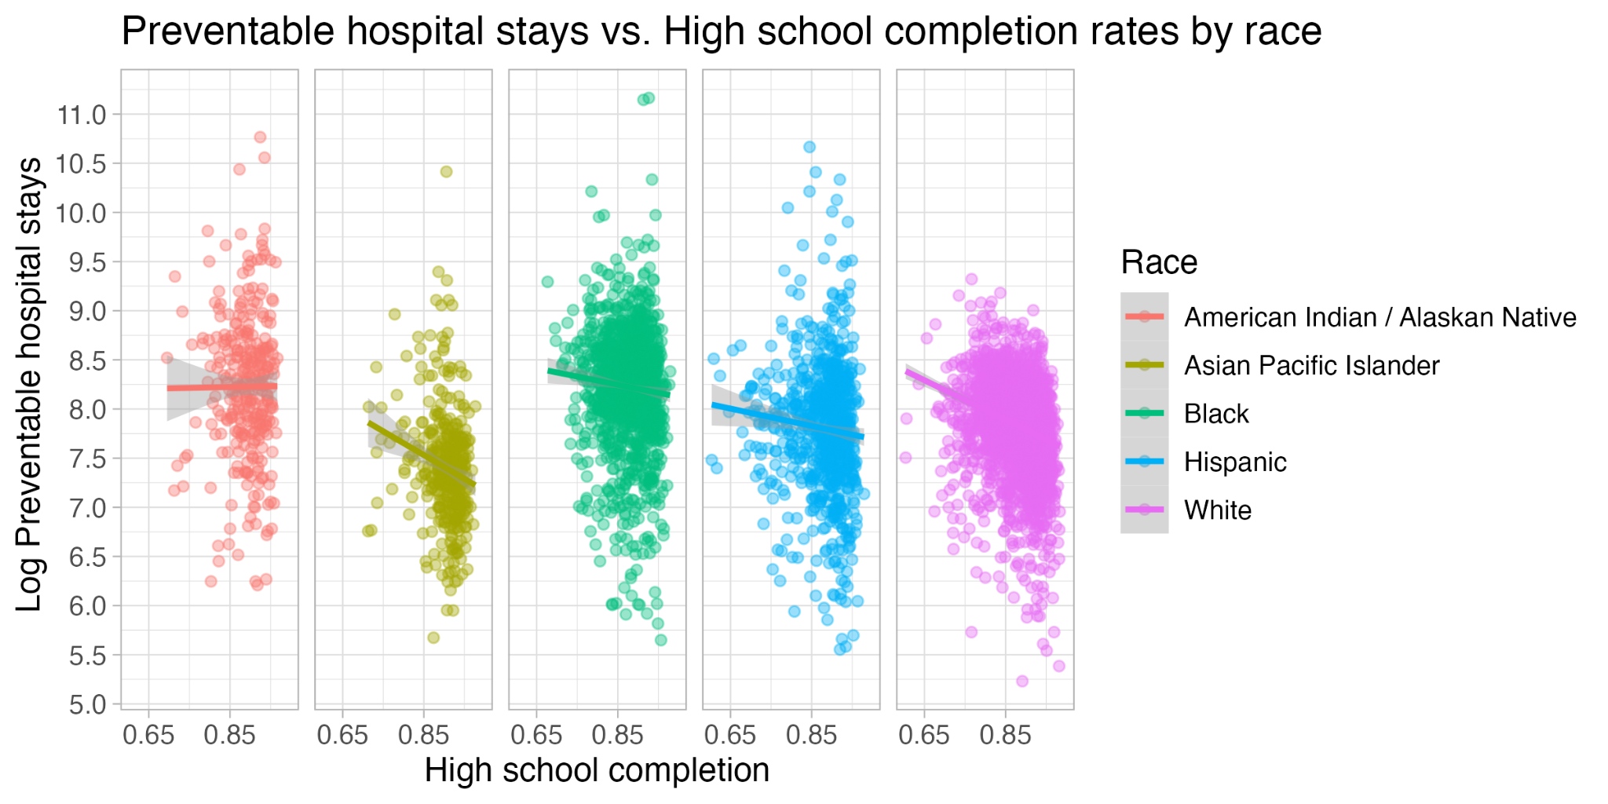
Counties with higher high school completion rates tend to have lower preventable hospital stays for most racial groups
Notes:
Jainiah
Races with higher high school completions have lower preventable hospital stays
Aian = American indian and Alaska Native (if anyone ask)
As shown on the graph, for all races except for native americans, counties with higher high school completion rates tend to have lower preventable hospital stays. This may be caused by the native american culture to support themselves and families from trade jobs rather than finishing a form of high school.With that being said we can make an inference that counties with higher school completion rates have knowledge about what their injury is and what actions can be taken compared to others who have yet to complete a form of high school
Along with that, research has shown that 83% of native americans from the ages of 3 to 18 no access to internet limiting their ability to obtain a form high school completion online
Don’t think that high school completion causes preventable
Checklist:
– Clearly explain all the elements of your graphs.
– What does each axis, color, point, shape, etc. represent? What is the unit scale? etc.
– Your plots should be big enough (font size, line width, point size, etc.)
– Pick better colors and themes. The figures should look expensive – Reformat variable names in plots (don’t show the original names in the data, or variable names with underscores/dots, etc.)
Checklist report:
Our group wanted to observe the relationship of high school completion rates by certain races and the rate of hospital stays for ambulatory care condition per 100,000 medicare enrollees . It is important to understand that the variable high school completion does not only mean someone graduating directly from high school, but also someone completing a high school completion program such as a G.E.D. From our findings we found that races with higher high school completions have lower preventable hospital stays except American Indian/Alaskan Native. For example, we can see the relation with the white race high school completion rates and preventable hospital stays. As more white people complete a form of high school at the county level, there is a significant decrease in preventable hospital stays. From this relation, we can make an inference that with higher school completion rates, the more likely these people have knowledge about what their injury is and what actions can be taken than others without completing some form of high school. Now there is a question of what factors going into one not completing a form of high school? While factors can range to working to support a family or economic disparities, our dataset provided teen births as a variable. This graph is a scatter plot showing the relationship between teen birth rates at the county level and high school completion rates. Each point on the graph represents data from a specific county.The x-axis shows the high school completion rates, ranging from 0.6 to 1.0, with 1.0 representing 100% completion. The y-axis shows the teen birth rates at the county level, ranging from 0 to 80 births per 1,000. A clear negative correlation is observed, as indicated by the downward-sloping blue line, which represents the trend. This suggests that counties with higher high school completion rates tend to have lower teen birth rates. The points are more densely packed towards the lower right, emphasizing the negative relationship.

Slide 6
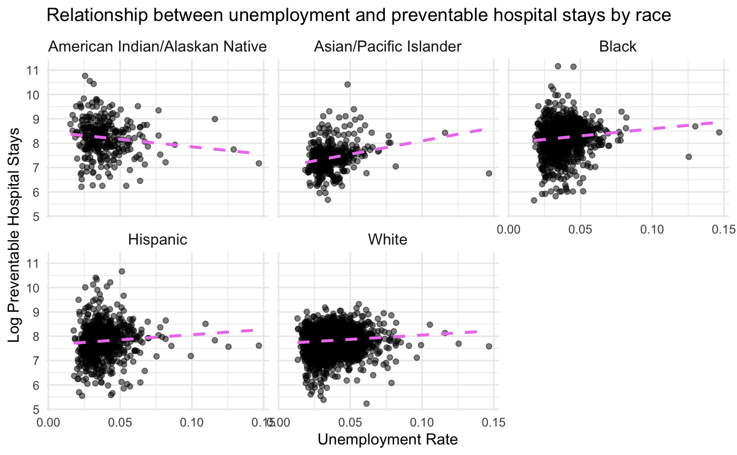
Counties with higher unemployment have more preventable hospital stays for most races except American Indian / Alaskan Native
Notes:
Macey
Tasked with analyzing the relationship between unemployment and preventable hospital stays. American Indian and Alaskan Native groups have consistently been the group with highest rates of unemployment in the US since the 1990s. This leads me to believe that this variable (unemployment) doesn’t have a significant impact on preventable hospital stays because its much more normal to be unemployed in these groups. These groups also have easy access to Indian Health Services, (federal health care), so there is less need to work and still receive proper outpatient services.
*Different economic structures and way of life
Traditional economic structures:
Reservations may have traditional economic structures that can contribute to unemployment.
– Clearly explain all the elements of your graphs.
– What does each axis, color, point, shape, etc. represent? What is the unit scale? etc.
– Your plots should be big enough (font size, line width, point size, etc.)
– Pick better colors and themes. The figures should look expensive
– Reformat variable names in plots (don’t show the original names in the data, or variable names with underscores/dots, etc.)
clean_data <- analytic_data2024 %>%
filter(
!is.na(`Unemployment raw value`),
!is.na(`Income Inequality raw value`),
!is.na(`High School Completion raw value`),
!is.na(`Preventable Hospital Stays raw value`)
)
clean_data <- clean_data %>%
mutate(
`Unemployment raw value` = as.numeric(`Unemployment raw value`),
`Income Inequality raw value` = as.numeric(`Income Inequality raw value`),
`High School Completion raw value` = as.numeric(`High School Completion raw value`),
`Preventable Hospital Stays raw value` = as.numeric(`Preventable Hospital Stays raw value`),
`Preventable Hospital Stays (AIAN)` = as.numeric(`Preventable Hospital Stays (AIAN)`),
`Preventable Hospital Stays (Asian/Pacific Islander)` = as.numeric(`Preventable Hospital Stays (Asian/Pacific Islander)`),
`Preventable Hospital Stays (Black)` = as.numeric(`Preventable Hospital Stays (Black)`),
`Preventable Hospital Stays (Hispanic)` = as.numeric(`Preventable Hospital Stays (Hispanic)`),
`Preventable Hospital Stays (White)` = as.numeric(`Preventable Hospital Stays (White)`)
)
cleaned_data <- clean_data |>
select(`State Abbreviation`, `Name`, `Release Year`,`Preventable Hospital Stays raw value`, `Income Inequality raw value`,`Unemployment raw value`, `High School Completion raw value`,
`Preventable Hospital Stays (AIAN)`, `Preventable Hospital Stays (Asian/Pacific Islander)`, `Preventable Hospital Stays (Black)`, `Preventable Hospital Stays (Hispanic)`, `Preventable Hospital Stays (White)`) |>
drop_na()
install.packages("ggcorrplot")
library(ggcorrplot)
long_data <- cleaned_data %>%
pivot_longer(cols = starts_with("Preventable Hospital Stays"),
names_to = "Race",
values_to = "Preventable_Hospital_Stays") %>%
mutate(Race = case_when(
Race == "Preventable Hospital Stays (AIAN)" ~ "AIAN",
Race == "Preventable Hospital Stays (Asian/Pacific Islander)" ~ "Asian/Pacific Islander",
Race == "Preventable Hospital Stays (Black)" ~ "Black",
Race == "Preventable Hospital Stays (Hispanic)" ~ "Hispanic",
Race == "Preventable Hospital Stays (White)" ~ "White"
)) |>
drop_na(Race)
ggplot(long_data, aes(x = `Unemployment raw value`, y = Preventable_Hospital_Stays)) +
geom_point(alpha = 0.5, color = 'black') +
geom_smooth(method = 'lm', se = FALSE, linetype = "dashed", color = 'violet') +
theme_minimal() +
theme(
axis.title = element_text(face = "bold", size = 12),
strip.text = element_text(face = "bold", size = 12)
) +
facet_wrap(~ Race) +
labs(
title = 'Relationship Between Unemployment and Preventable Hospital Stays by Race',
x = 'Unemployment Rate',
y = 'Preventable Hospital Stays'
) +
ylim(0, 2500)

Slide 7
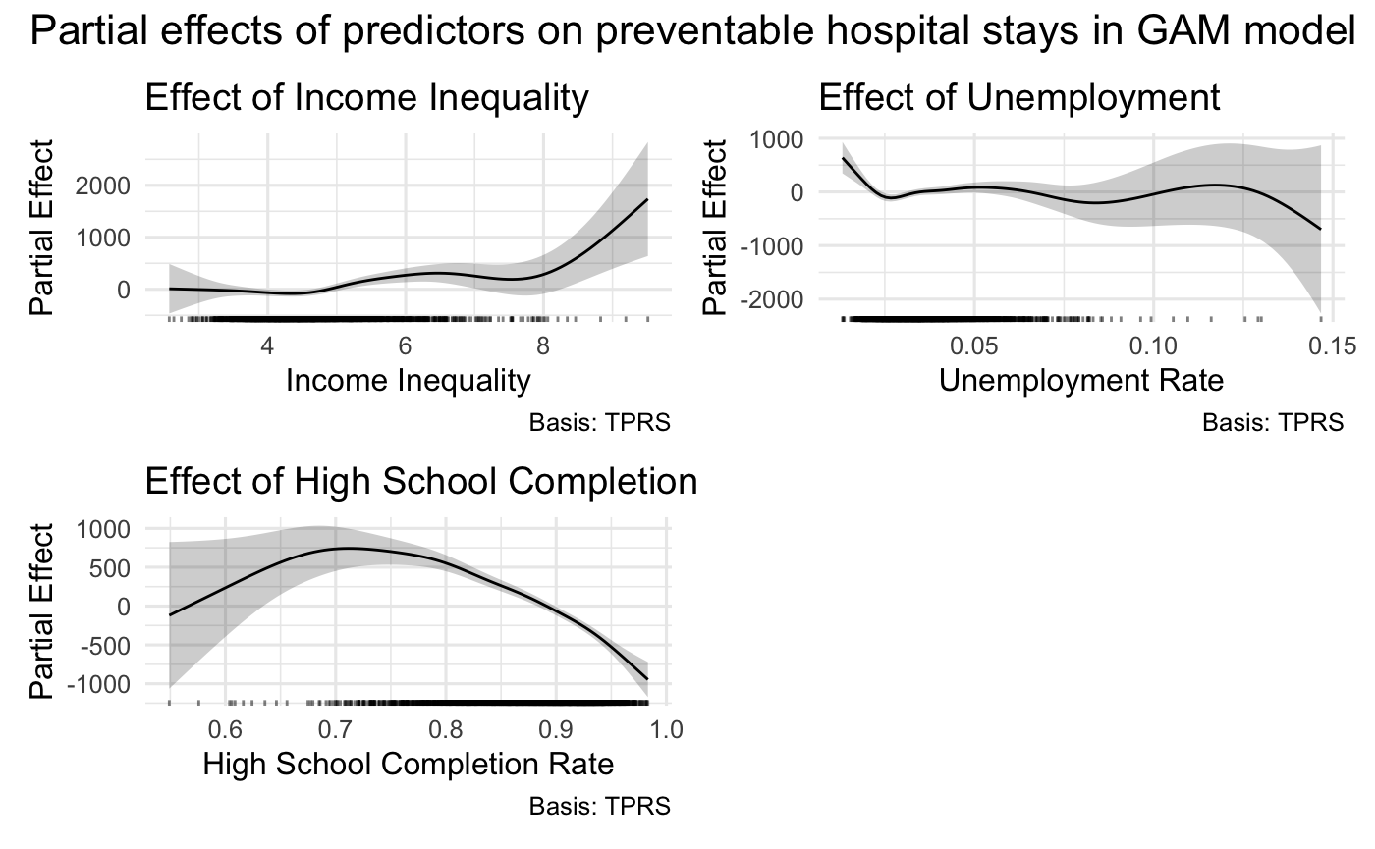
Higher income inequality increases preventable hospital stays, while more high school completion decreases preventable hospital stays
Notes:
Nicole
Chose GAM to balance capturing nonlinearity with interpretability
GAM: response is a linear combination of smooth functions of each predictor
0 for the y-axis represents the average value of the predictor. Negative values mean the predictor reduces the response below the average value. Positive values mean the predictor increases the response above the average value.
Ex. the point at an unemployment rate of 0.05 can be interpreted as, “A partial effect of 1.2 suggests that at the 5% unemployment rate, there is an estimated increase of 1.2 preventable hospital stays compared to the baseline, holding all other variables constant”
Income inequality: the partial effect increases significantly with higher levels of income inequality. This suggests that counties with greater income inequality tend to have more preventable hospital stays. The effect becomes more pronounced as income inequality rises, indicating a strong positive association. This finding aligns with existing literature that links income inequality to poorer health outcomes, likely due to disparities in access to healthcare resources and preventive care.
Unemployment: It looks like counties with low unemployment tend to increase predicted preventable hospital stays, but when I looked into it, there are a handful of rural counties that have very low unemployment but really high preventable hospital stays that are driving the partial effect up. In reality, unemployment does not seem to have a strong effect on preventable hospital stays
High school completion: At first it looks like the partial effect is increasing but the data is pretty sparse here so it's unclear, but as high school completion rates increase, it does appear that this reduces preventable hospital stays in the model.
High school completion: Reduce preventable hospital stays at very high completion rates.
Percent Non-Hispanic Black: We see an initial decrease in the effect, followed by a sharp increase after around 70%, suggesting that racial composition of a county can impact preventable hospital stays.

Slide 8
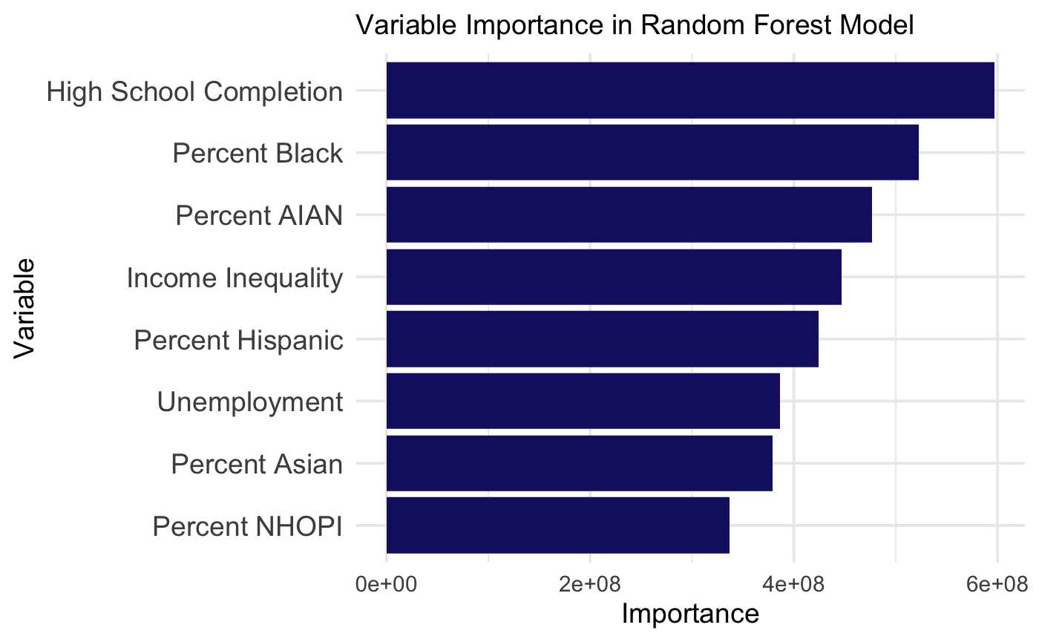
High school completion and percent black appear to be most important in predicting preventable hospital stays
Notes:
Nicole
NHOPI = Native Hawaiian or Other Pacific Islander.

Slide 9
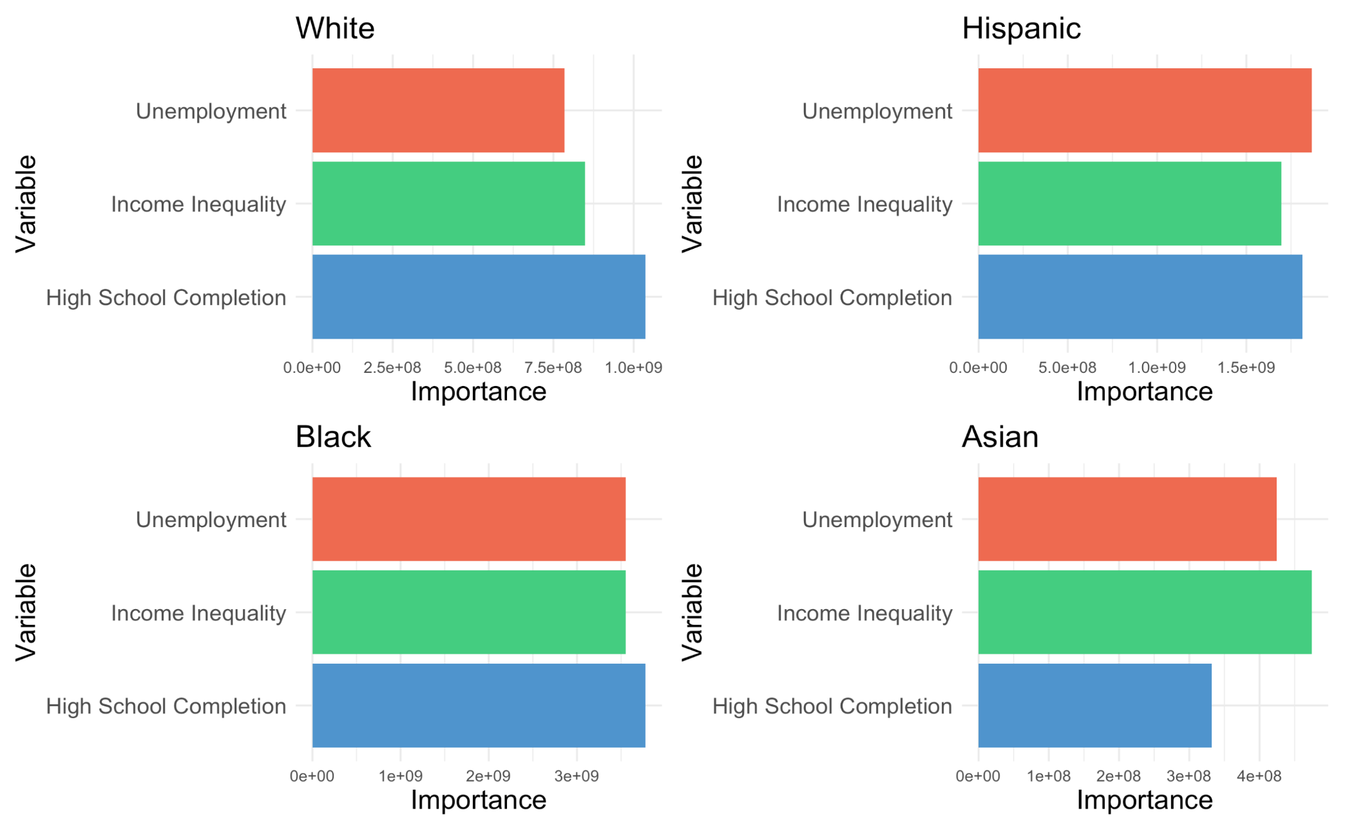
Variable Importance in Predicting Preventable Hospital Stays by Racial Group
Notes:
Nicole
Make x-axis the same, set min and max, same range
Fix positions of y-variables
Urban vs Rural, where people live, hs completion more about majority poor communities, income inequality about people living in urban environments, structural / systemic factors for black but also income inequality cuz urban

Slide 10
Takeaways
1. Counties with higher income inequality tend to have higher rates of preventable hospital stays.
2. As more people in a county complete high school, fewer individuals go to the hospital for preventable conditions.
3. High school completion is most important in predicting hospital stays for white and black people, while income inequality is most important for asians.
Notes:
Macey
2. “Lose access to certain outpatient services that they need, end up in the hospital when their condition or illness worsens”
Counties with higher income inequality tend to have higher rates of preventable hospital stays.
When almost everyone has a job, even a small increase in unemployment can lead to more preventable hospital stays.
As more people in a county complete high school, fewer individuals go to the hospital for preventable conditions.

Slide 11
Limitations / Future Directions
Income inequality, high school completion, unemployment not available for each race
Variables such as access to healthcare services, community support, and poverty rate might better predict preventable hospital stays
Conclusions only for individuals 65 and older which excludes younger people who also experience preventable hospital stays
Notes:
Cristina
The data for income inequality, high school completion, and unemployment rates are not available for each racial group. This means we must use overall county averages for these variables, potentially overlooking how these socioeconomic factors specifically impact different racial groups.
There are additional factors that likely influence preventable hospital stays but are not included in our analysis. Variables such as access to healthcare services, health behaviors (e.g., smoking, diet, physical activity), community support, poverty rates, and housing stability can significantly impact health outcomes
Our conclusion is limited to individuals aged 65 and older. While this focus is relevant for understanding healthcare outcomes among Medicare beneficiaries, it excludes younger people who may also experience preventable hospital stays.
With future research, we would try to expand our analysis with these factors in order to improve our models and see if our findings generalize. We do not know if the racial disparities we found also exist for younger people.

Slide 12
Future directions
Investigate appropriateness of model
Examine other influencing factors
Expand age range of data
Notes:
Counties with higher income inequality tend to have higher rates of preventable hospital stays.
When almost everyone has a job, even a small increase in unemployment can lead to more preventable hospital stays.
As more people in a county complete high school, fewer individuals go to the hospital for preventable conditions.

Slide 13
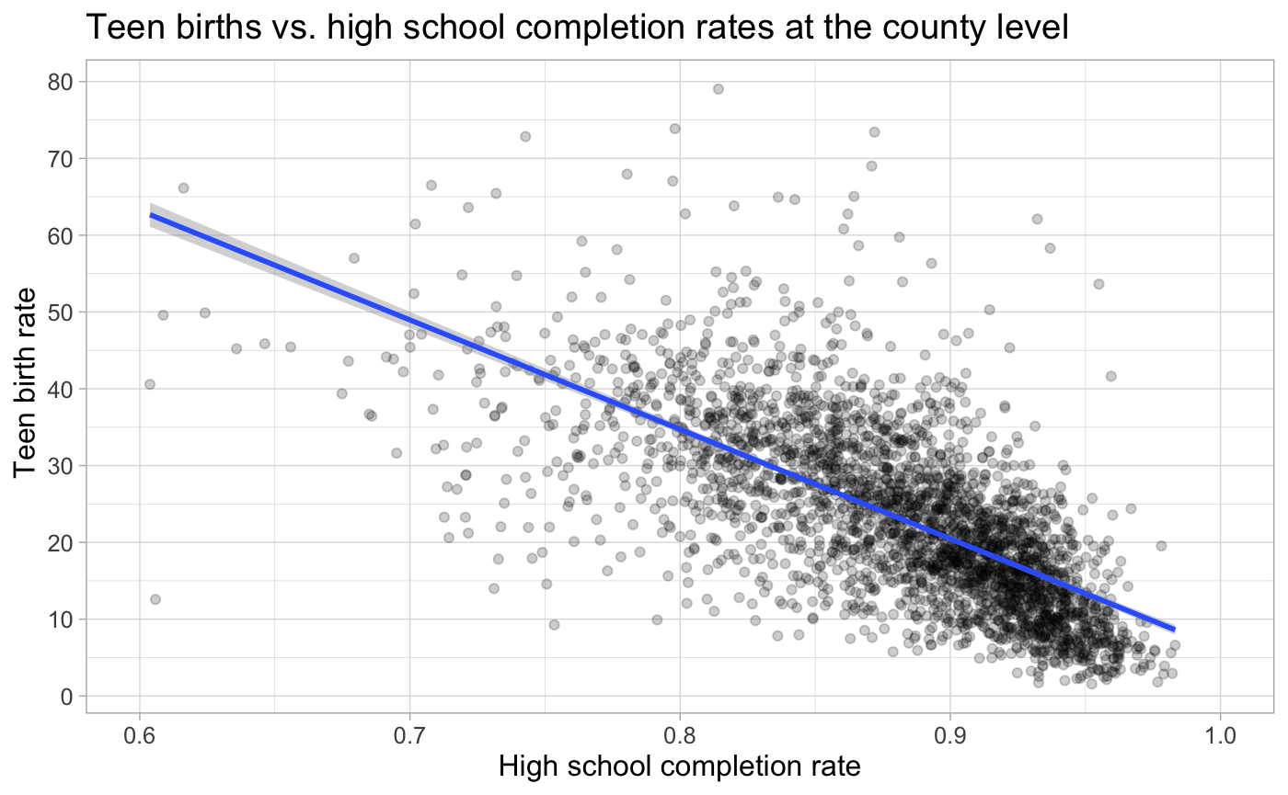
Teen births may influence high school completion rates
Notes:
After seeing the relationship of high school completion and preventable hospital stays , we wanted what factors may cause lower high school completion rates. In our dataset, we were given the the variable of teen births. As shown on the screen we can see that as certain county have higher teen birth rates, they have lower high school completion rates. We can correlate this information with previous graph and create a Presumption that these teens have less knowledge about pregnancies or injuries that they may experience causing them to call for ambulatory care.
Number of births per 1,000 female population ages 15-19. The 2024 Annual Data Release used data from 2016-2022 for this measure.

Slide 14
Plan of action
1. EDA to visualize relationships between variables
2. Break down associations by race
3. Create model to predict preventable hospital stays
4. Understand relative predictor importance for each race
5. Look into potential confounding variables that affect preventable hospital stays for certain races
Notes:
Do more EDA like scatterplots and correlation plots to see the relationships between our variables
Also, we looked generally at how income inequality is associated with preventable hospital stays, but we want to break that down by race to see if there are any differences.
We also are going to look at some other variables besides the ones we mentioned to see if there are any confounding variables that can account for the associations we found. It is possible that something like income or children in poverty could explain some of the correlations we found.

Slide 15
Preventable Hospital stays = the number of hospital stays for ambulatory-care (medical services performed on an outpatient basis, without admission)sensitive conditions per 100,000 Medicare enrollees(65+, end stage renal failure, other disabilities.
Income Inequality = Ratio of household income at the 80th percentile to income at the 20th percentile. The 2024 Annual Data Release used data from 2018-2022 for this measure.
Unemployment = Percentage of population ages 16 and older unemployed but seeking work
Teen Births - Number of births per 1,000 female population ages 15-19. The 2024 Annual Data Release used data from 2016-2022 for this measure.

Slide 16
Methods
GAMs, random forest
Notes:
Checklist
• What are you modeling (i.e. what is the response)? What are the relevant predictors (including confounders)?
– Be sure you are able to justify why a predictor is useful in your modeling problem
– Do not just say generic things like “strong correlation”
– How did you choose the predictors? Does it make sense? (Did you have any domain knowledge, think about the context, or perform extensive EDA?)
• What are the modeling techniques you consider? Justify why they are appropriate for the problem, and your plan for comparing/evaluating different methods
– Be simple. Just state the different models you considered and how you obtained the final model (e.g., via cross-validation, due to its interpretability, etc.).
– A concrete summary is enough. (For example, something like “We considered linear regression, lasso and random forests, and determined the best model using cross-validation. . . ” should be enough)
• DO NOT include plots showing cross-validation results, comparison between models, etc. Put these in the Appendix.
– (Why? The general audience won’t care. Just put these in the Appendix in case anyone is curious about your model selection procedure during the Q&A.)
Note: Make sure you know what you’re doing here. . . If you’re using code from lecture slides, make sure to understand what actually is going on behind those lines of code.

Slide 17
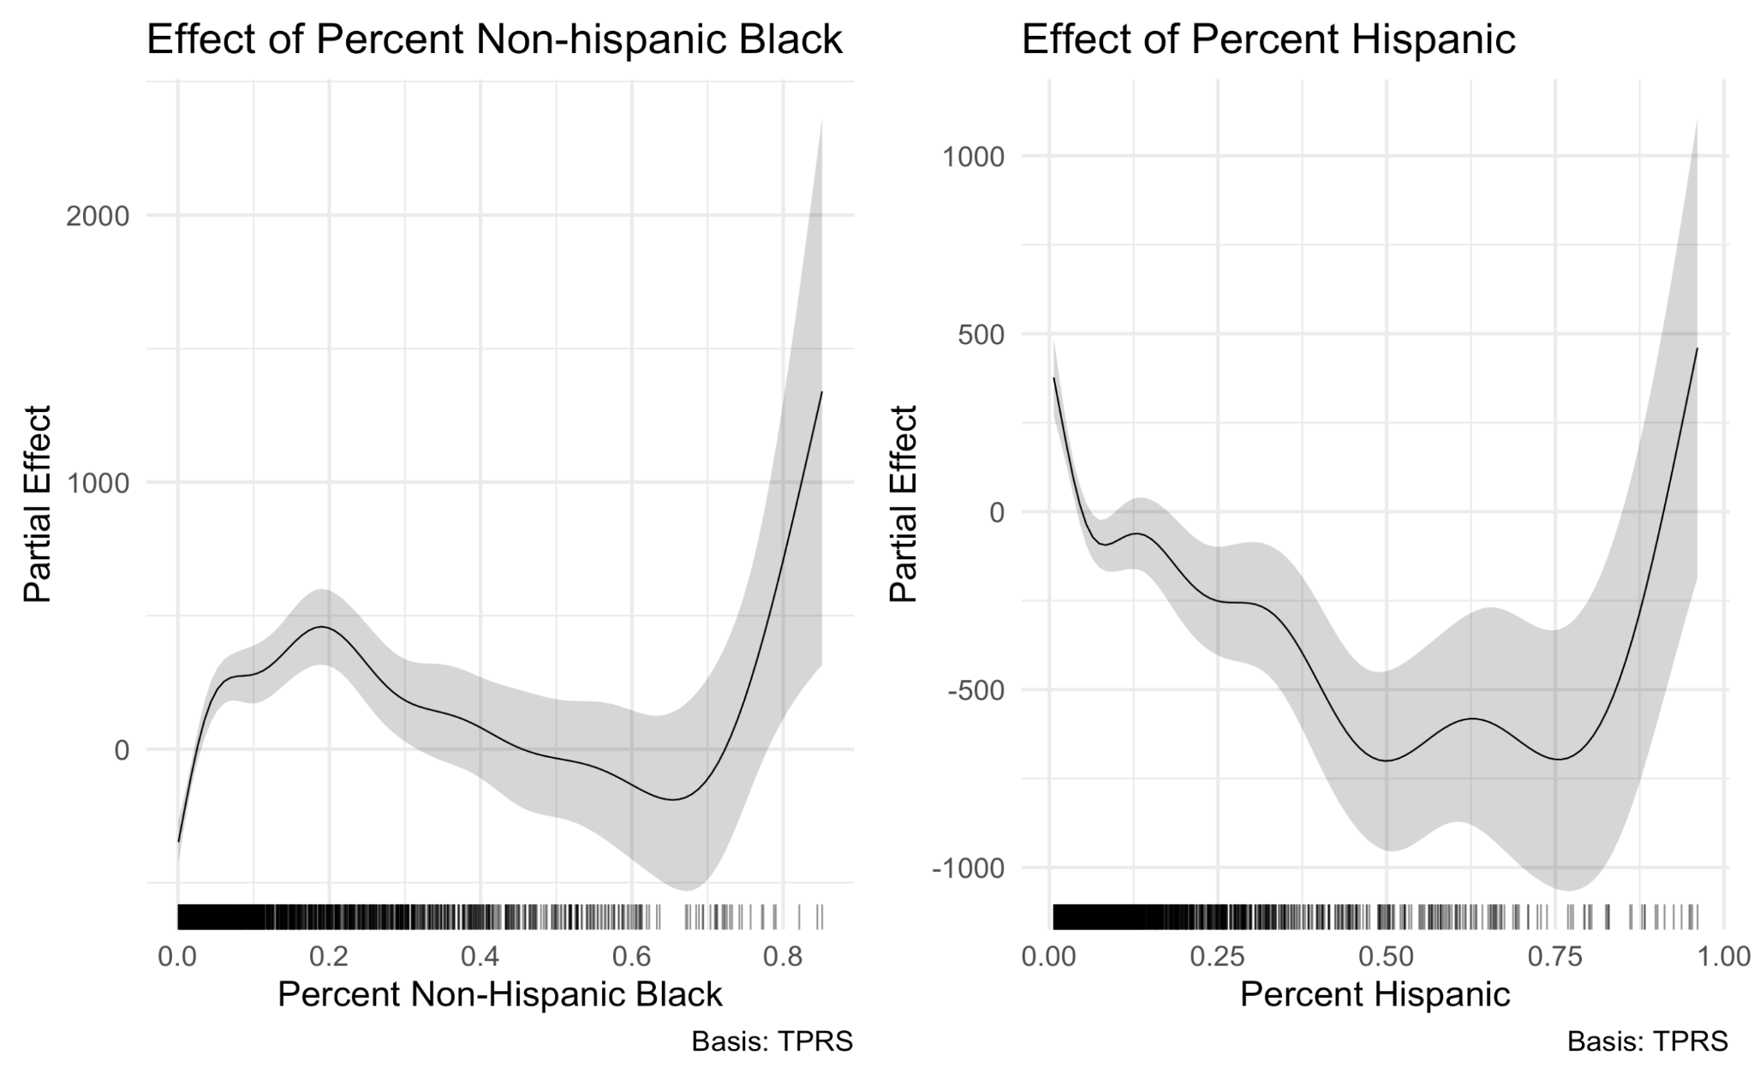
Relationships between percent black/hispanic and preventable hospital stays appear nonlinear
Notes:
Basis: TPRS refers to the type of splines used in the smoothing function
Could be a racial effect due to previous encounters with healthcare professionals not taking people’s conditions seriously
For both races we see decreases in the partial effect until about 75% after which there is a sharp increase. This suggests that there are probably other underlying factors like income and access to care that might be influencing preventable hospital stays

Slide 18
Methods
Scatterplots to explore relationships between variables
Cross validation to compare different models for predicting preventable hospital stays
Validate GAM model assumptions
Examine partial effects of predictors in GAM model
Random Forest for each race to visualize relative variable importance
Notes:
Methods (1 slide): Early thoughts on methods/modeling strategy. Justify why it might be appropriate to answer your question(s) of interest

Slide 19
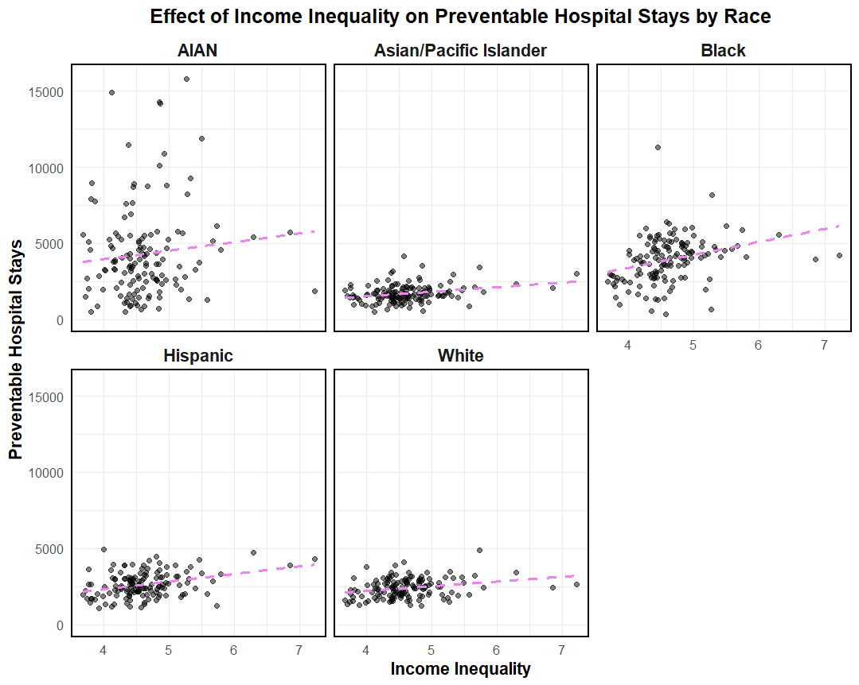
Income inequality has the strongest correlation with preventable hospital stays among hispanic communities.

